Slide 1

Autotests for iOS apps with Appium
Attestation seminar of Vasily Biryuk
(You can see explanatory information in the speaker's comments)

Slide 2
Seminar plan:
What is Appium?
Mobile Application Types
Why Choose Appium
Appium Architecture
How does Appium work on an iOS device?
Appium Philosophy
Appium pros and cons
What needs to be installed on the machine to work with Appium
Configuring the WebDriverAgent
Desired Capabilities
Preparing the Eclipse IDE
Finding Items in an Application
Create a simple test
Adding an Extents Report to a Project
Results

Slide 3
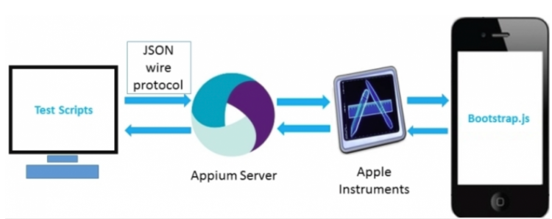
What is Appium?
Appium is a free and open source framework for testing the user interface of mobile applications. It helps to test native, hybrid and web applications and perform automated testing on physical devices, as well as using an emulator and simulator. It offers cross-platform application testing - a single API works for both Android and iOS platform testing scenarios.
It is not burdened by dependence on the operating system of the mobile device - Appium has a framework or shell that translates Selenium Webdriver commands into UIAutomation (iOS) or UIAutomator (Android) commands depending on the type of device, and not any type of OS.
Appium supports all languages with Selenium client libraries such as: Java, Objective-C, JavaScript with node.js, PHP, Ruby, Python, C#, etc.

Slide 4
Mobile Application Types
Native apps are apps developed for a specific mobile platform (such as iOS or Android) using native tools and programming languages. Such applications have quick access to the device's hardware resources and the best performance, but require the development of a separate version for each platform.
Hybrid apps are apps that use web technologies (HTML, CSS, JavaScript) to create a user interface and access native device capabilities through an app-packaged browser (such as a WebView). Hybrid apps can run on multiple platforms with a single codebase, but typically have slower performance than native apps.
Web applications are applications that run in a browser on a mobile device and do not require downloading to the device. Such applications usually require an Internet connection, but can run on any platform that supports a browser.
Progressive Web Applications (PWAs) are web applications that can be stored on a user's device and run offline, as well as use device features (such as notifications, camera and location access). PWAs can run on any platform that supports a browser and can provide a smoother and faster user experience than regular web apps.
Notes:
Examples:
Examples for iOS: Safari (browser), Camera (camera), Messages (messages), Calendar (calendar), Maps (maps).
An example of a hybrid app is Instagram, which is a photo and video sharing app that is developed using the React Native framework. The application has native features such as camera and geolocation and works on two platforms - iOS and Android.
An example of a mobile web application is Trello, an online project management tool that also has a mobile version of the web application. Users can create boards, task lists, cards and manage their projects on their mobile devices.
One example of a mobile progressive web application (PWA) is Twitter Lite. Twitter Lite is a mobile application that has been developed to improve the accessibility and performance of using the social network Twitter on mobile devices.
Twitter Lite is a PWA, which means users can access the app through any modern web browser on a mobile device. However, Twitter Lite has a lot of features that are usually only available in native apps, such as notifications, the ability to add an icon to the home screen, and work offline. PWAs are usually lightweight and load quickly, making them easy to use on mobile devices. They can also be added to the home screen and run without the need for installation, which improves accessibility and user experience.

Slide 5



Why choose Appium?
Appium:
Free and open source
Supports iOS and Android apps
The tester does not need the source code of the application
No need to constantly reinstall the application
Appium supports multiple frameworks and programming languages
Strong and active community
Selendroid:
Free and open source
Supports Android only
You need the source code of the application or the application library that was used during development
Only support Android 2.3-4.4
Compatible with Selenium and Jenkins
The community is not as strong as Appium
Robotium:
Free and open source
Supports Android only
You need the source code of the application or the application library that was used during development
The slightest code changes in Robotium lead to a rebuild of the build
Only Java programming language is supported. Not compatible with Selenium and Jenkins
Not a strong community

Slide 6
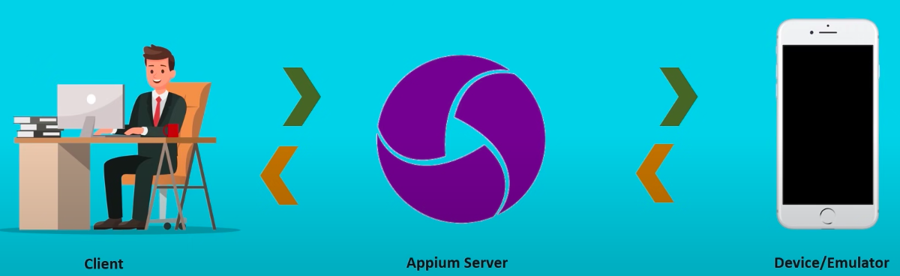
Appium Architecture
Appium is an HTTP server written in node.js that creates and handles multiple WebDriver sessions for different platforms such as iOS and Android. Appium runs a "test case" on a device that spawns a server and listens for proxy commands from the main Appium server.

Slide 7
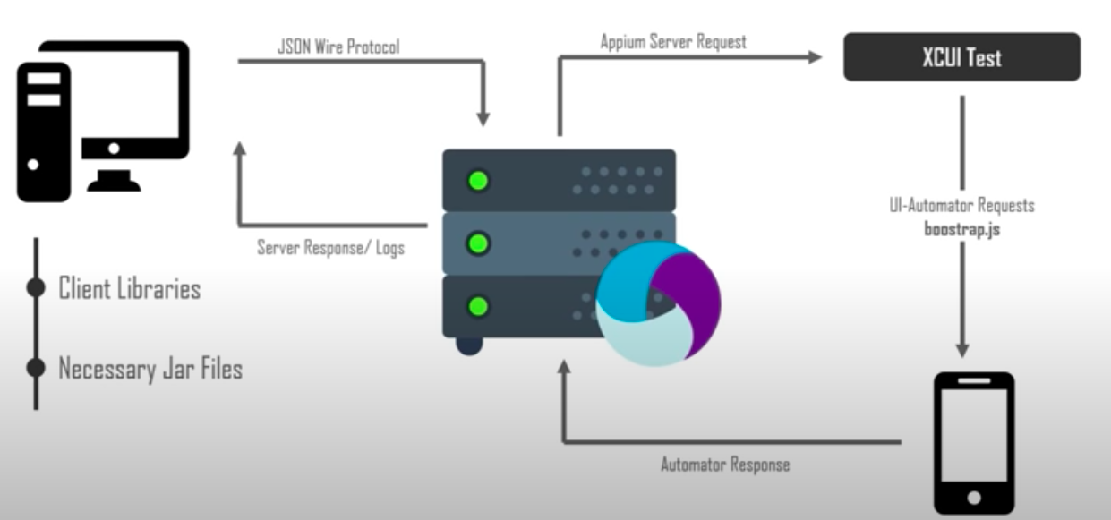
How does Appium work on an iOS device?
Notes:
Appium "proxies" the command to the XCUITest script, which runs in the Mac Instruments environment. It is designed for profiling, controlling and building applications, and also has a component for automation. You can write commands in JavaScript in it, and through the XCUITest API, the commands interact with the interface. Appium automation works through these libraries.
Above is the Appium architecture in the context of automation on iOS. The life cycle of a command looks like this: Selenium web driver accepts a command in code and sends it, in JSON form, as an HTTP request to the Appium server. This server processes the context (iOS or Android) and sends the command to the Instruments command server (running on node.js), which “picks it up” and executes it through bootstrap.js in the Instruments iOS environment. After executing the command, the client sends a response to the Appium server, which is logged with details.

Slide 8
Appium Philosophy
You don't need to recompile the application or modify it in any way to automate it.
You don't have to be tied to a particular language or framework in order to write and run your tests.
A mobile automation platform shouldn't reinvent the wheel when it comes to automation APIs.
A mobile automation framework should be open source, both in spirit and practice, as well as in name!
Notes:
Earlier attempts at automation were based on OCR (Optical Character Recognition) and pixel-based interactions, which history tells us were never very reliable, that we saw the introduction of agents in an application that can execute underlying code that would otherwise would be launched by the user interacting with the application. These agents then call the same code causing user actions such as swipes, taps. It's not a bad idea, but it comes with the fact that you need to compile these agents into your application while it's being tested, and you'll probably want to remove it after testing is complete. As a result, you don't actually test the code you release. Therefore, the agent's approach is a little strange, since the user's actions in the real world take place outside the application itself. So if you model your actions in code rather than triggering them with the corresponding UI actions, you are a lot further away from the actual experience of a real person. To solve the problem and provide testing with these more real users, Apple and Google have created automated testing frameworks that work in their respective development environments. Google provides UI Automator which is a Java API to simulate these UI actions on Android devices and emulators, while Apple provides a UI Automation tool, a JavaScript programming interface for use by iOS devices and simulators. Therefore, the Appium service translates your test code into platform-specific interactions, and I think this is a better approach than using an agent, since you do not need to compile the test, and create one that contains code that will not be in the production assembly.
The following two points of philosophy are considered together as they both stem from the decision to implement the Web Driver API and the JSON wire protocol, so you don't have to be tied to a specific language or framework to write and run your test, and a mobile automation framework doesn't have to reinvent the wheel when it comes to comes to API automation, so webdriver is already well known as the engine behind Selenium to automate testing of web applications.

Slide 9
Appium pros and cons
Pros:
Complexity Encapsulated
Cross-platform
No external agent required
Minuses:
Difficult to scale
Notes:
Pros:
The complexity of the testing environment is completely encapsulated, so the beauty of Appium is that all the complexity is under the hood of the Appium server, and for the automation developer, the programming language and the whole experience remains independent of the platform it automates, i.e. iOS or Android.
Doors open for cross-platform mobile testing
Appium does not require you to include any additional agent in your application to make it suitable for automation.
Minuses:
Difficult to scale - one poppy machine for one iOS device

Slide 10
What you need to install to work with Appium
Homebrew
Node.js и npm
Appium и Appium Doctor
Xcode и Xcode Command Line Tools
Carthage
Authorize-ios
Ios-deploy
UI Automator 2
XCUITest
Libimobiledevice
Appium-gestures-plugin
Notes:
Homebrew (package management for Mac) - in the terminal, run the command: /bin/bash -c "$(curl -fsSL https://raw.githubusercontent.com/Homebrew/install/master/install.sh)"
Node.js and npm (Node Package Manager) - run the command in the terminal: brew install node
Install Appium and Appium Doctor (a utility for checking the configuration) - in the terminal, run the commands: npm install -g appium@next npm install -g appium-doctor
Xcode Command Line Tools (if they are not already installed) - in the terminal, run the command: xcode-select --install
Carthage (if you plan to use testing on iOS devices) - in the terminal, run the command: brew install carthage
If you have problems installing carthage (you have a mac on m processor), then install Rosseta 2 first https://www.makeuseof.com/what-is-rosetta-2-mac/
Run the following command to install carthage
arch -x86_64 brew install carthage
Authorize-ios
authorize-ios is a small utility that pre-authorizes tools for running UIAutomation scripts on iOS devices. It is required to run tests on real devices.
In the terminal, enter the following command to install authorization-ios:
npm install -g authorize-ios
Appium support for real devices running iOS 9.3 and above using Xcode 8+ also depends on ios-deploy, which is readily available via Homebrew:
brew install ios-deploy
UI Automator 2 by running command in terminal
appium driver install uiautomator2
Install XCUITest by running command in terminal
appium driver install xcuitest
Libimobiledevice.
Support for real Appium iOS devices depends on a central third-party software package, libimobiledevice, which is easily installed using Homebrew:
brew install libimobiledevice
Appium-gestures-plugin.
Run the command in terminal:
appium plugin install --source=npm appium-gestures-plugin

Slide 11
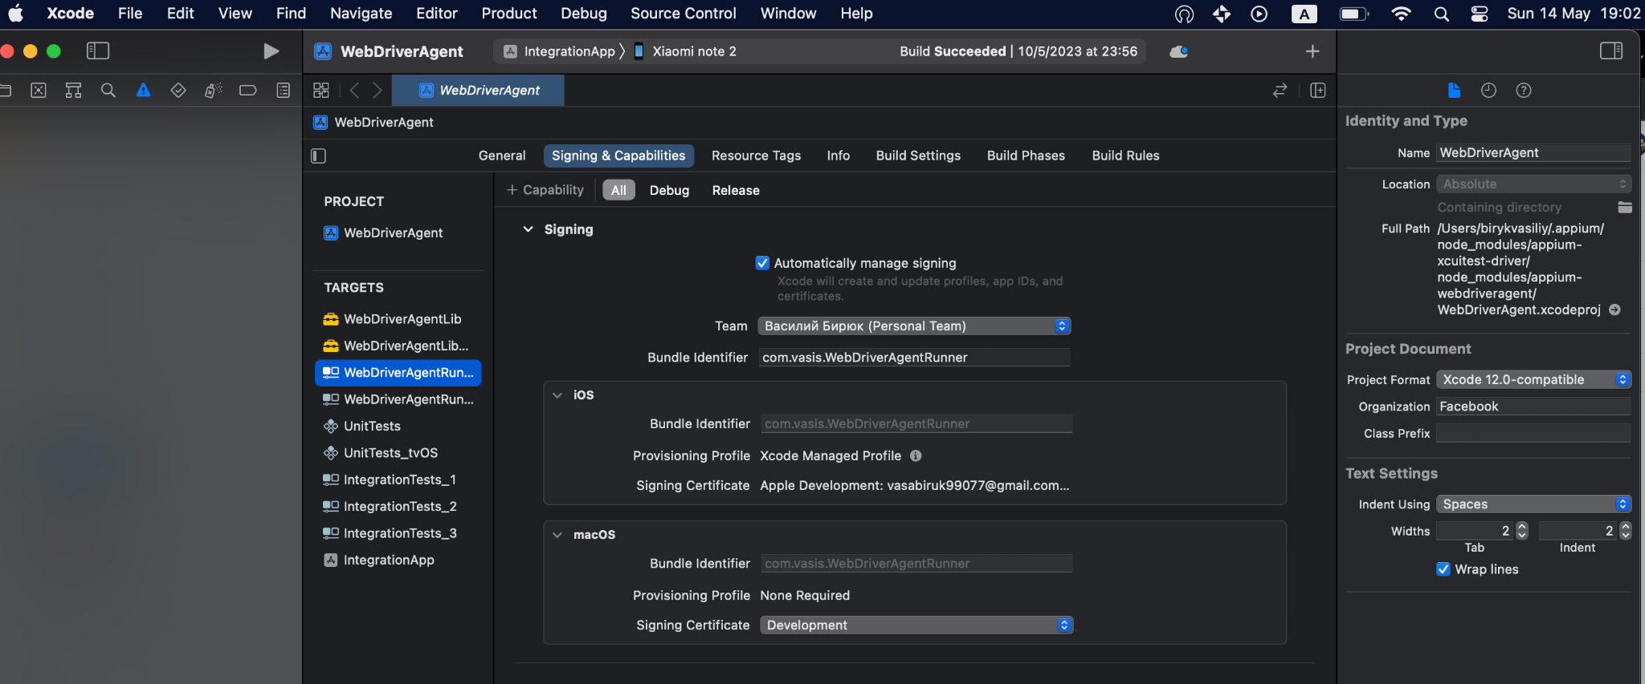
Configuring the WebDriverAgent
Notes:
https://appium.readthedocs.io/en/latest/en/drivers/ios-xcuitest-real-devices/
Usually the project is located in the following path:
/Users/YOUR_ACCOUNT_NAME/.appium/node_modules/appium-xcuitest-driver/node_modules/appium-webdriveragent
Open Finder, use command+shift+G and paste this address
When you get to the folder, then open the file WebDriverAgent.xcodeproj
Select your device you want to use
Please note that you need to enable developer mode on the device, translate the UI Automation toggle, and when connecting the device to the Mac, you must agree to trust the computer.
Next, we are concerned with three targets:
WebDriverAgentLib
WebDriverAgentRunner
IntegrationApp
You need to go to each of these targets and go to the Signing & Capabilities tab and check the Automatically manage signing checkbox, in the Team drop-down list you need to select a personal team (PS: you can use your developer account to create it - go to developer.apple.com/account ) and change the Bundle Identifier to whatever is available, it is important to remove the word “facebook” and replace it mainly with it.
Each of these targets must be selected in front of the device and installed directly on the device, so we will make sure that WDA will successfully stand on the test device and will not bring any problems in the future.

Slide 12
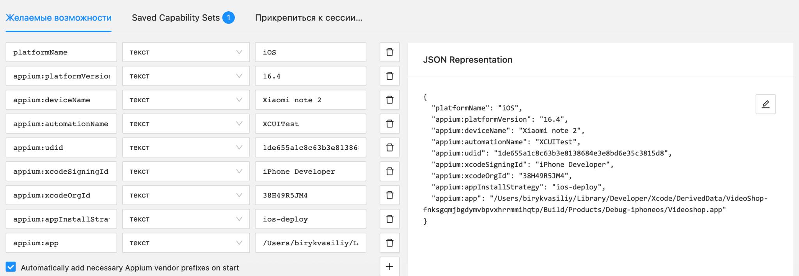
Desired Capabilities
Notes:
Desired Capabilities in Appium is a key part of setting up and running automated tests on mobile devices or emulators using Appium.
Desired Capabilities are a set of key-value pairs that define the configuration of the device or emulator under test, as well as other parameters such as platform, operating system version, device name, and so on.
In the context of Appium, Desired Capabilities are specified as an object of the DesiredCapabilities class (depending on the programming language being used). They are passed to Appium Server to specify the parameters for running an automated test on the target device or emulator.
The combination of different Desired Capabilities allows you to define the required device or emulator for testing, as well as other parameters related to application automation.
Next, we need to know a few important things:
Full path in the .xcodeproj project file of the application under test. Open the project in Xcode and on the right in the Identity and Type column you will see the Full path. Copy this value UDID of your device and simulator.
Open Xcode -> Window tab -> Devices and Simulators -> Click on the desired real device or simulator and copy the value in the Identifier line. Development team ID.
Open Keychain Access -> Select the key of your development team -> Copy the string of 10 characters that will be in brackets.
To start a session, Appium uses Desired Capabilities where we specify:
{
"platformName": "iOS",
//Tested platform
"appium:platformVersion": "16.3.1",
//Axis of your device
"appium:deviceName": "[KG]iPhone 11",
//Name of your device
"appium:automationName": "XCUITest",
//Automation method
"appium:udid": "00008030-001A4C1E2E50802E",
//Previously recorded important information, so Appium Server will understand exactly which device to use
"appium:xcodeSigningId": "iPhone Developer",
"appium:xcodeOrgId": "38H49R5JM4",
//Previously recorded important information, so the server will understand which certificate to use
"appium:appInstallStrategy": "ios-deploy",
"appium:app": "/Users/birykvasiliy/Library/Developer/Xcode/DerivedData/VideoShop-fnksgqmjbgdymvbpvxhrrmmihqtp/Build/Products/Debug-iphoneos/Videoshop.app"
//Previously recorded important information, application path
}
For debugging, we use this information in the Appium Inspector, where we pass this data as a value key and, when Appium Server is running, we start a session.
To pass the test, we enclose this information in the code in the @Before section already in Java.
https://github.com/felipeqa/appium-1/blob/master/docs/en/writing-running-appium/caps.md

Slide 13
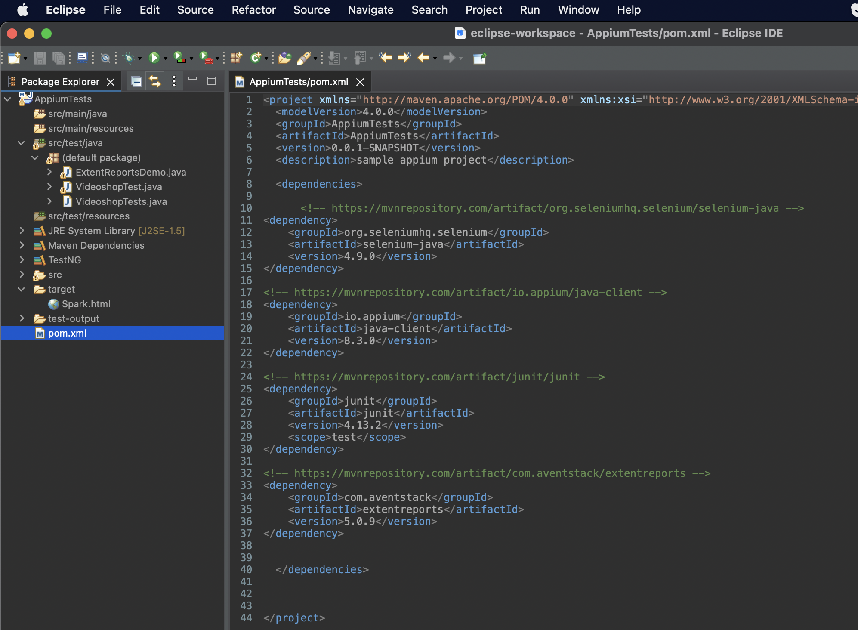
Preparation
Eclipse IDE
Notes:
Download Eclipse from the official Eclipse website. Select the Java Developers version of the Eclipse IDE. https://www.eclipse.org/downloads/
Open Open Eclipse and follow these steps:
File -> New -> Other… -> In the input field, enter “Maven” -> click on the appeared button “Maven project” -> click on the “Next” button -> click on the checkbox “Create a simple project” -> Click on button “Next” -> fill in the input fields “Group id” and “Artifact id”, you can also add some description -> click on the button “Finish”.
This way Maven will take care of all our dependencies.
Expand the tree of the previously added project and open the “pom.xml” file.
Go to the following links and copy the Maven code and paste it into the code in the "pom.xml" file
Selenium Java https://mvnrepository.com/artifact/org.seleniumhq.selenium/selenium-java/4.9.0
Java client https://mvnrepository.com/artifact/io.appium/java-client/8.3.0
JUnit https://mvnrepository.com/artifact/junit/junit/4.13.2
ExtentReports https://mvnrepository.com/artifact/com.avenstack/extentreports/5.0.9
In the expanded project tree, right-click on src/test/java -> New -> Class -> enter a valid class name -> then activate the checkbox “public static void main(String[] args)” -> Click on the “Finish” button.
In this created class, we will write autotests.
https://www.youtube.com/watch?v=N7vY3cPSo8g&list=PLhW3qG5bs-L8npSSZD6aWdYFQ96OEduhk&index=9

Slide 14

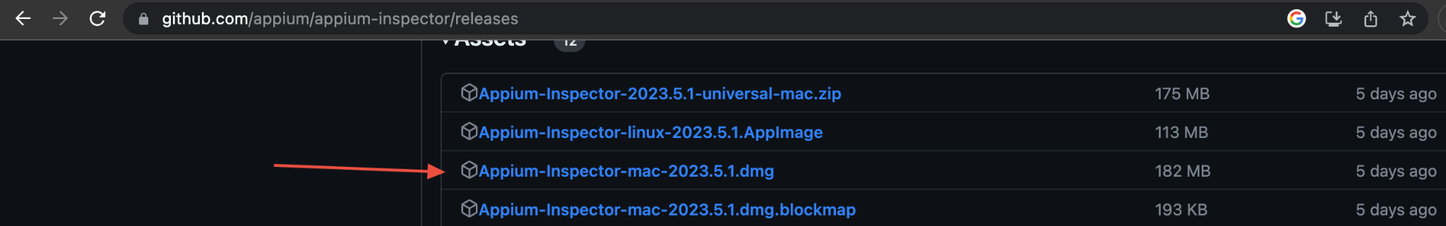
Finding Items in an Application
Notes:
Finding elements is necessary to specify them in our code and then run tests. To do this, you need to use the Appium Inspector.
Download Appium Inspector https://github.com/appium/appium-inspector/releases

Slide 15
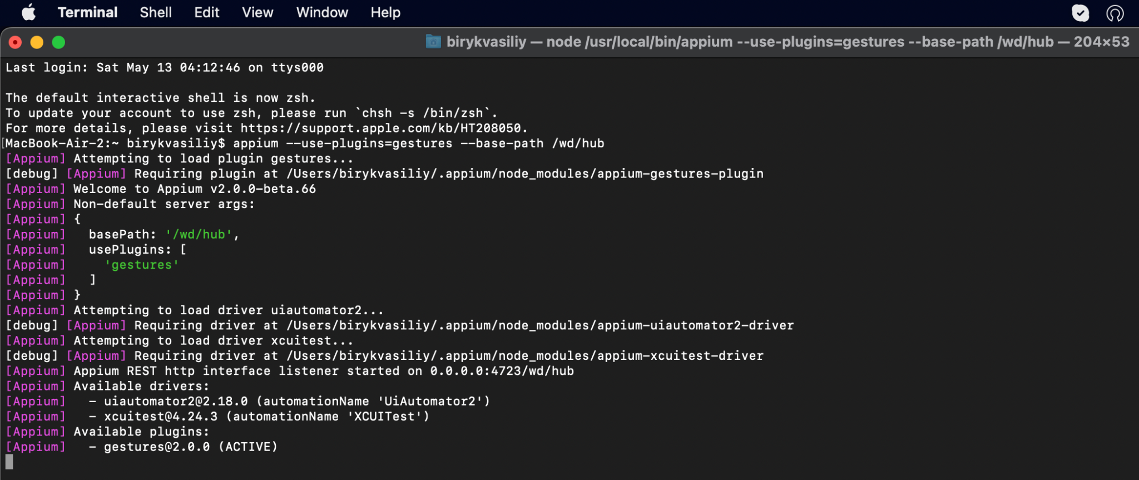
Notes:
Start your Appium Server with the command: appium --use-plugins=gestures --base-path /wd/hu
Before doing this, be sure to run the command in the terminal: appium plugin install --source=npm appium-gestures-plugin
This is required to install the gesture plugin

Slide 16
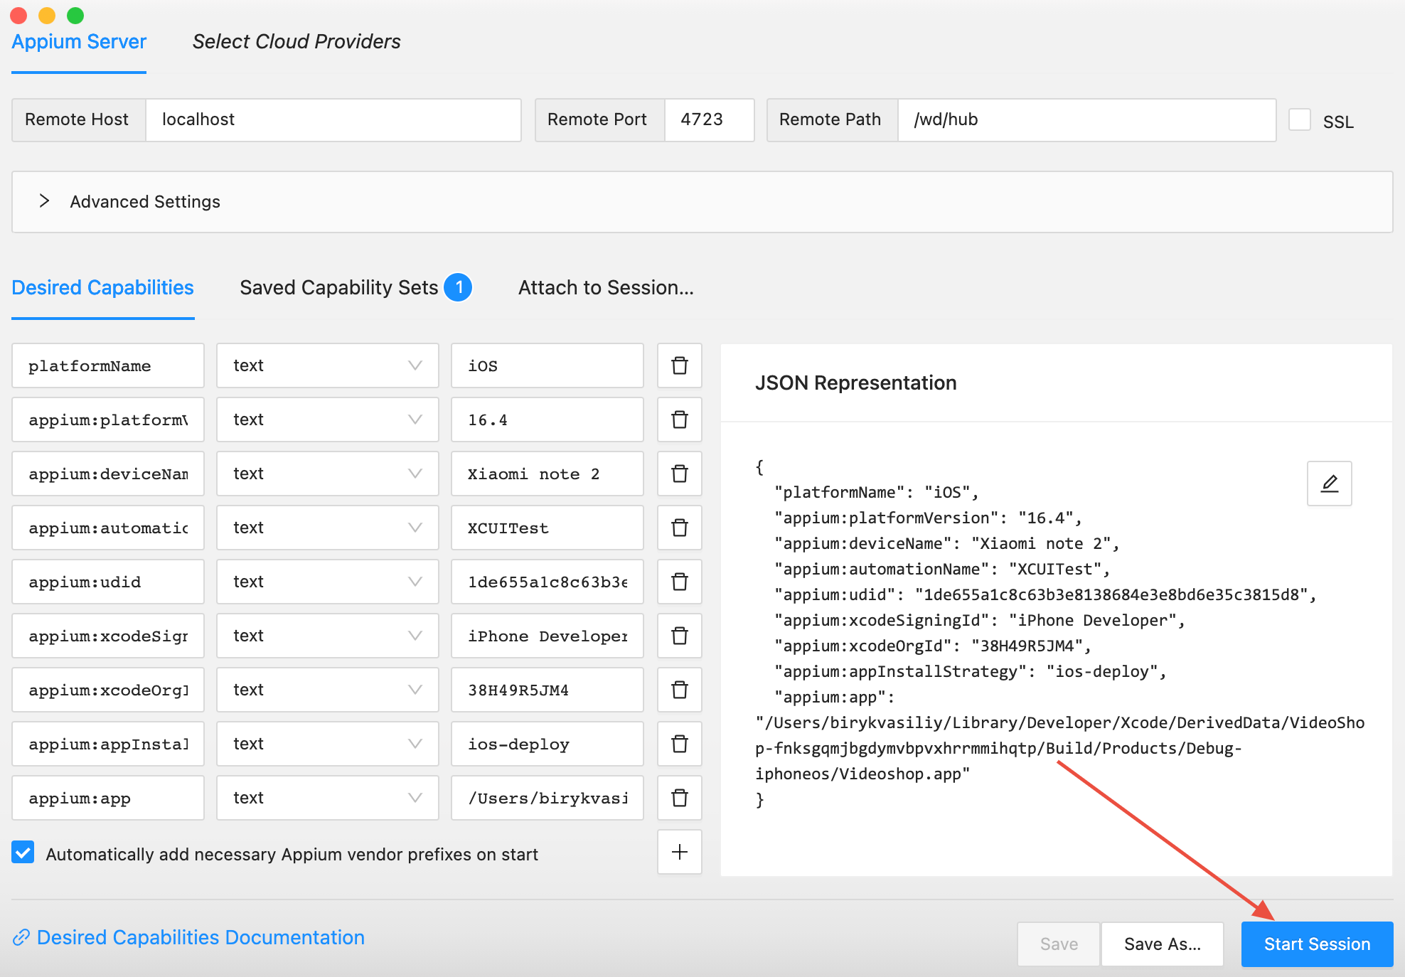
Notes:
Open Appium Inspector and run a session on your simulator or real device using the previously explored desired features. Don't forget to save your session settings.

Slide 17
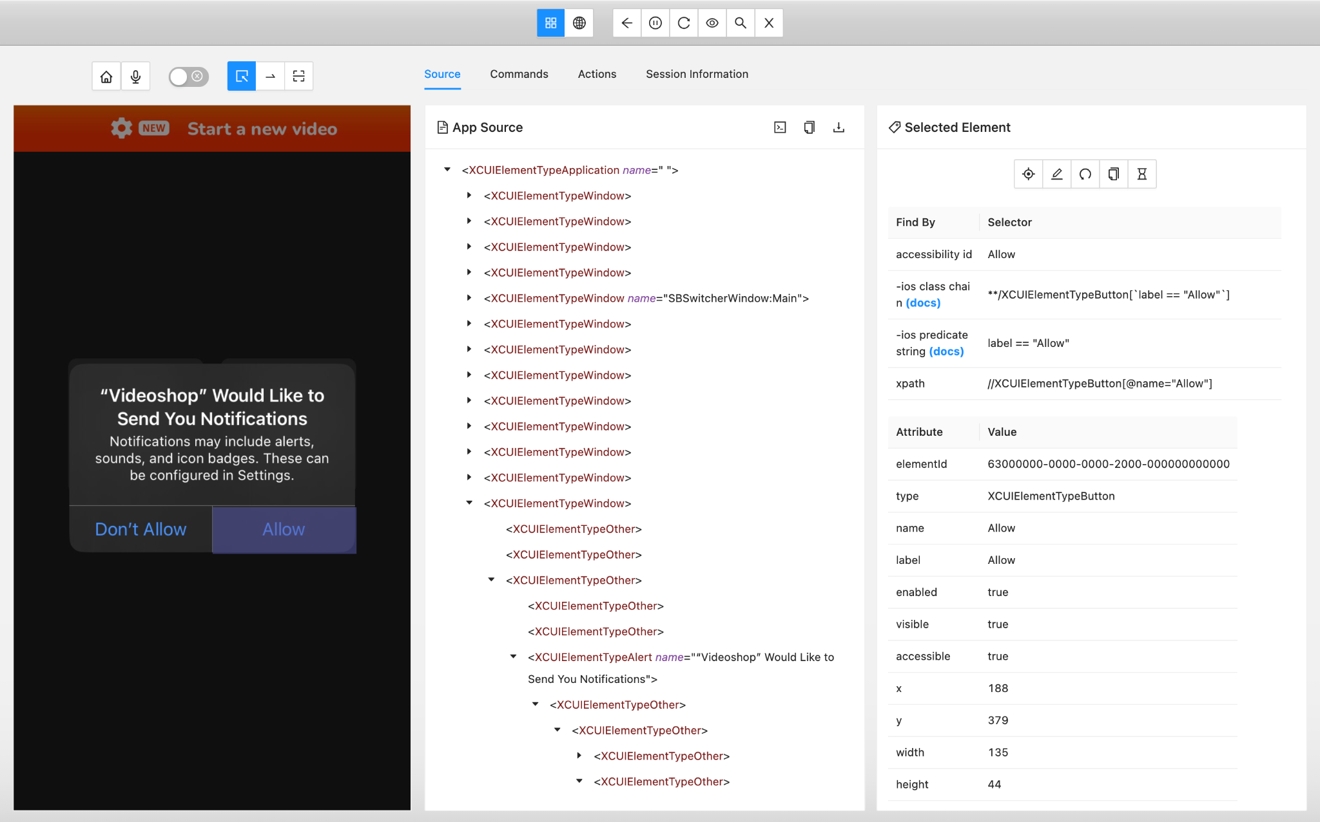
Notes:
After starting the session and installing the application on the simulator or real device, the appium inspector window will change and be divided into three sections.
The first section will contain the user interface, which is also displayed on the simulator or real device
The second section contains the hit code for the specific screen we are on.
In the third section, we can identify the locators.

Slide 18
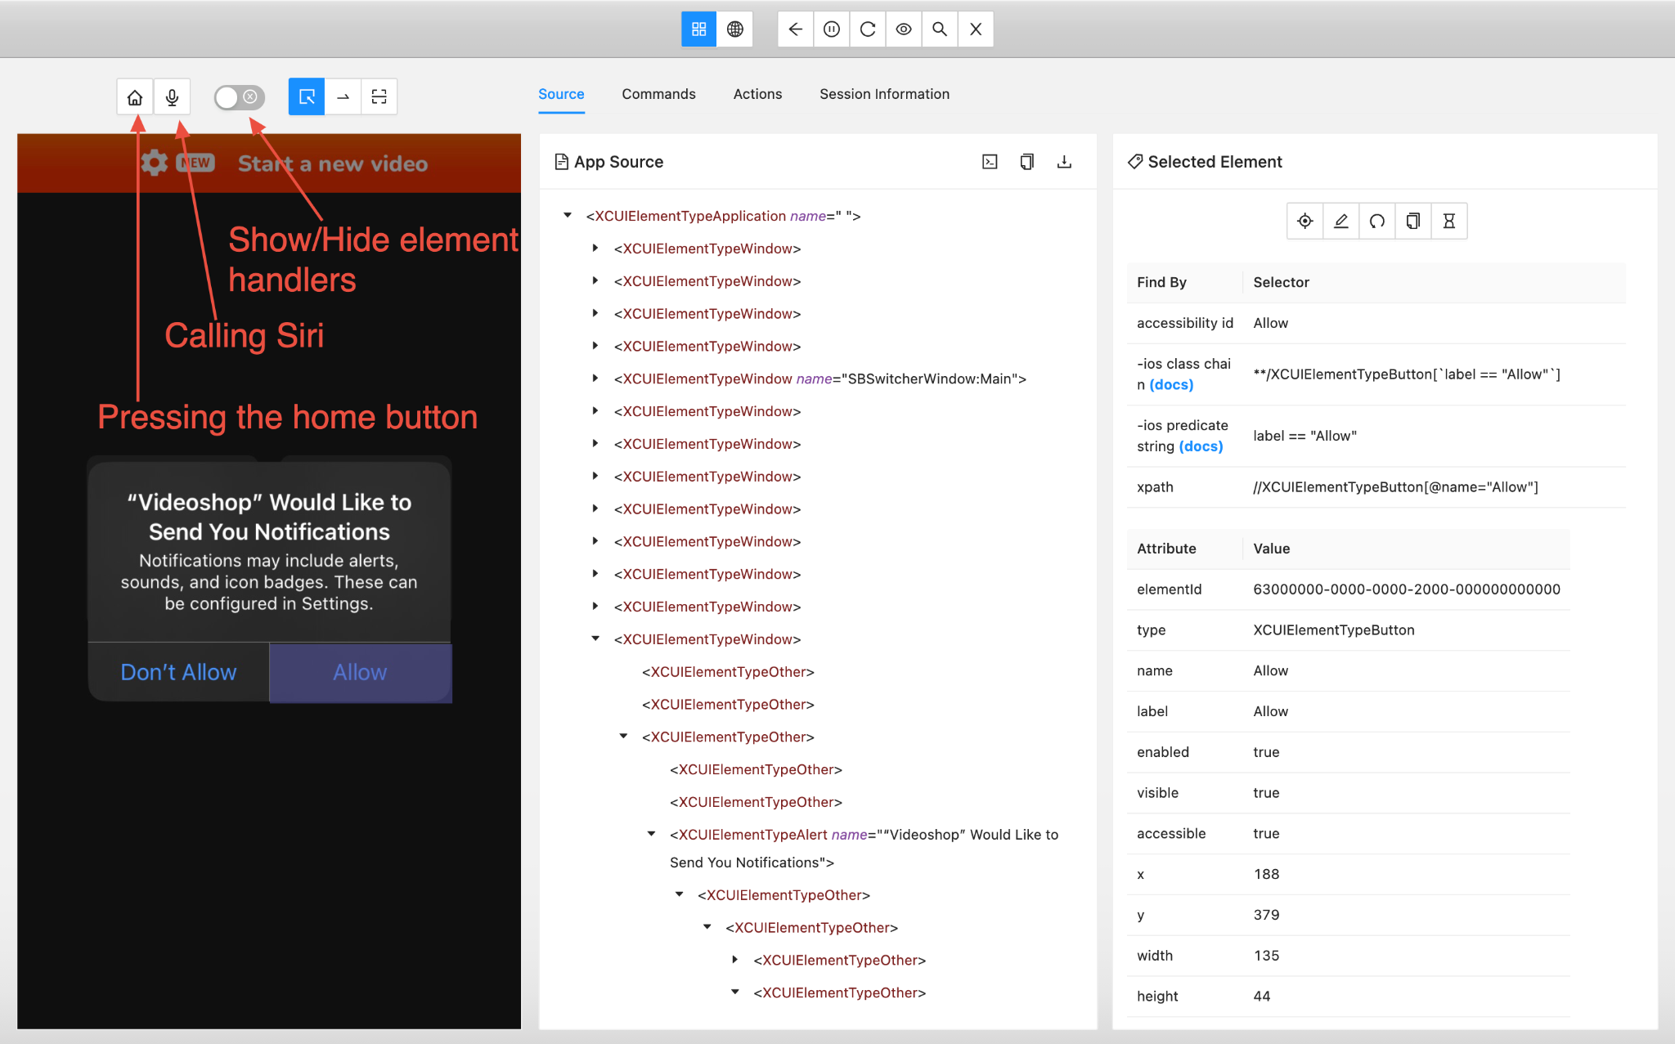
Notes:
On the top bar, we can select an action:
Press the home button
Start a Siri command call
Show or hide element handlers

Slide 19
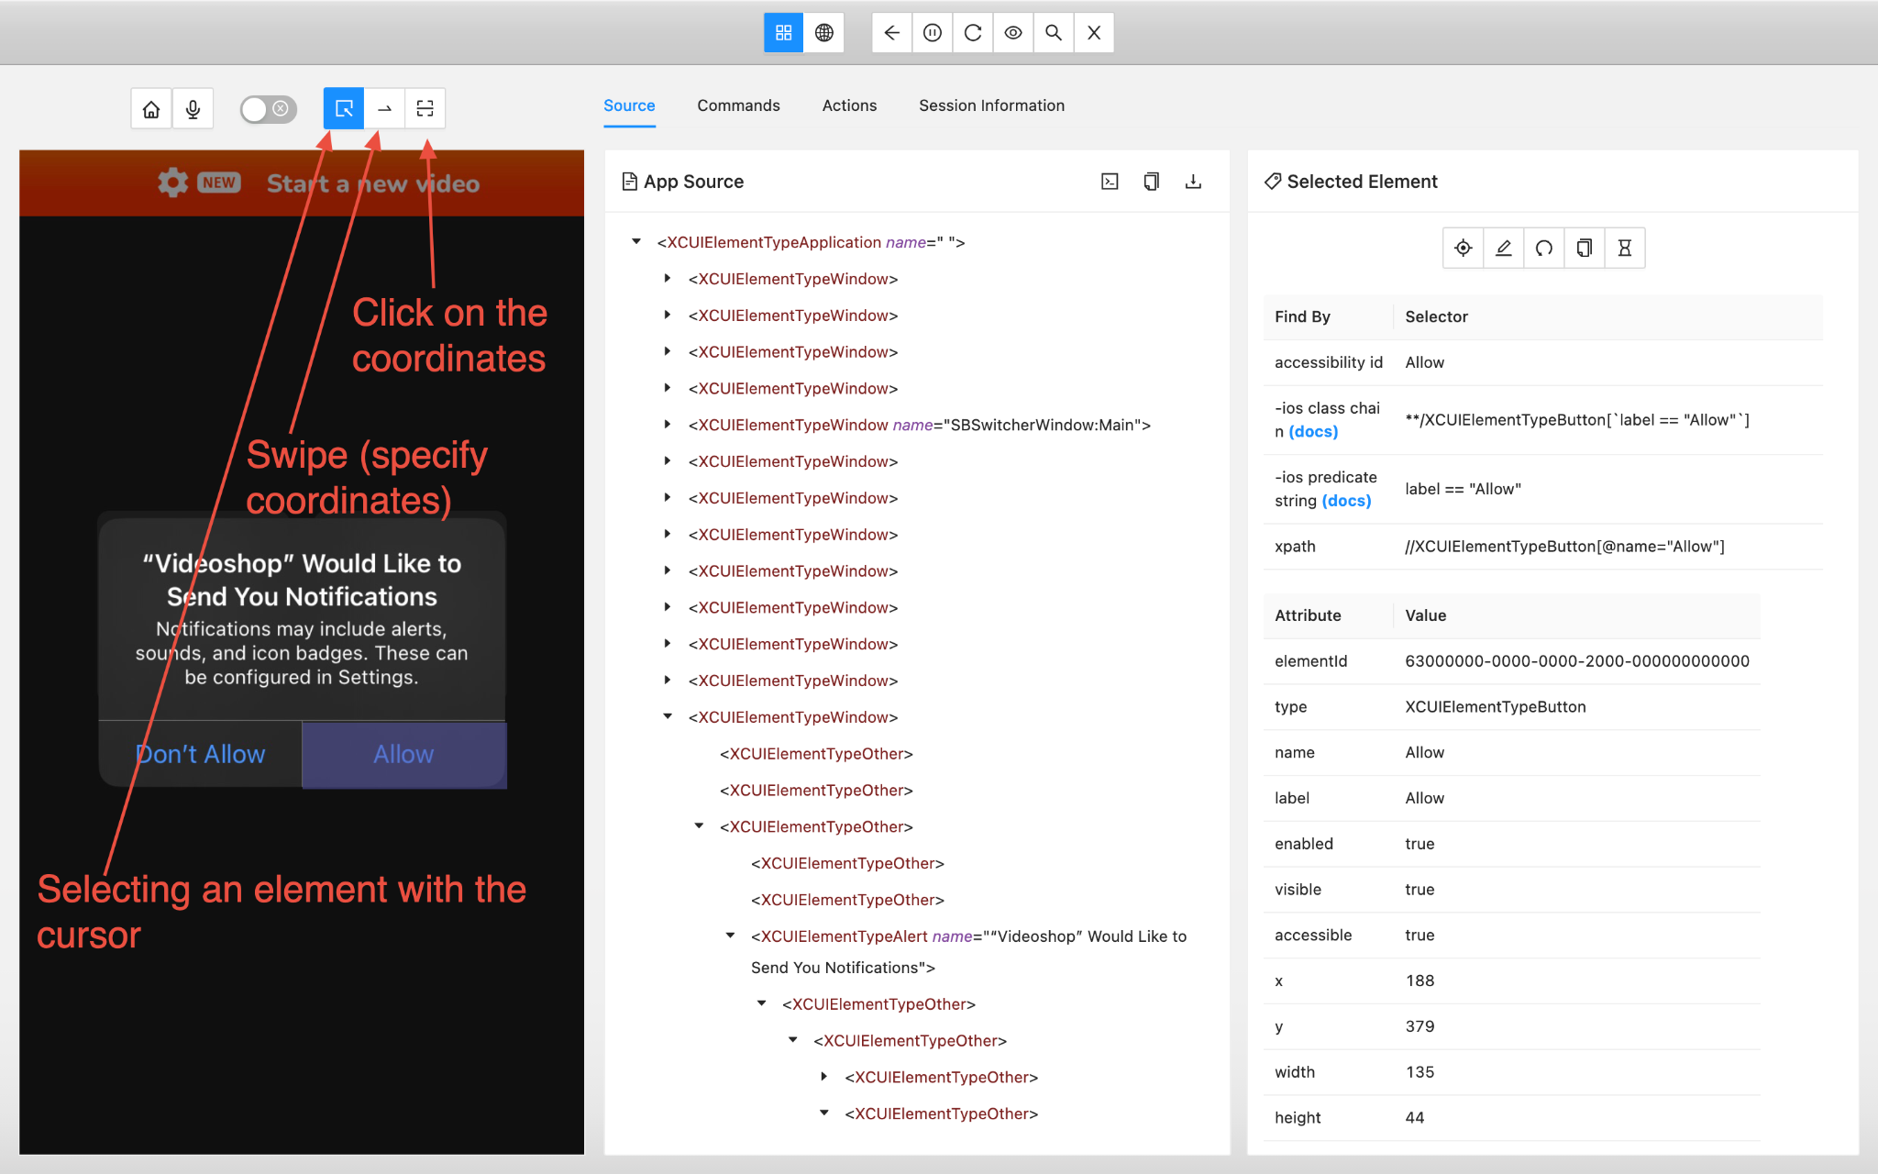
Notes:
We can also choose what can be done with the cursor:
1. Select elements
2. Swipe (specify coordinates)
3. Click on the coordinates
Here you can also talk about the fact that you can switch between existing tabs
Source
Command execution
Actions
Information about the session (+ what code the session started with)

Slide 20
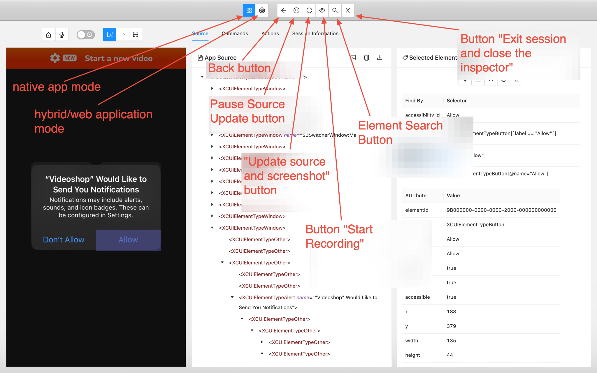
Notes:
You can also select native app mode or hybrid/web app mode
There are also buttons:
Back
Pause source update
Update source and screenshot
Start Recording
Finding an element
Exit the session and close the inspector

Slide 21
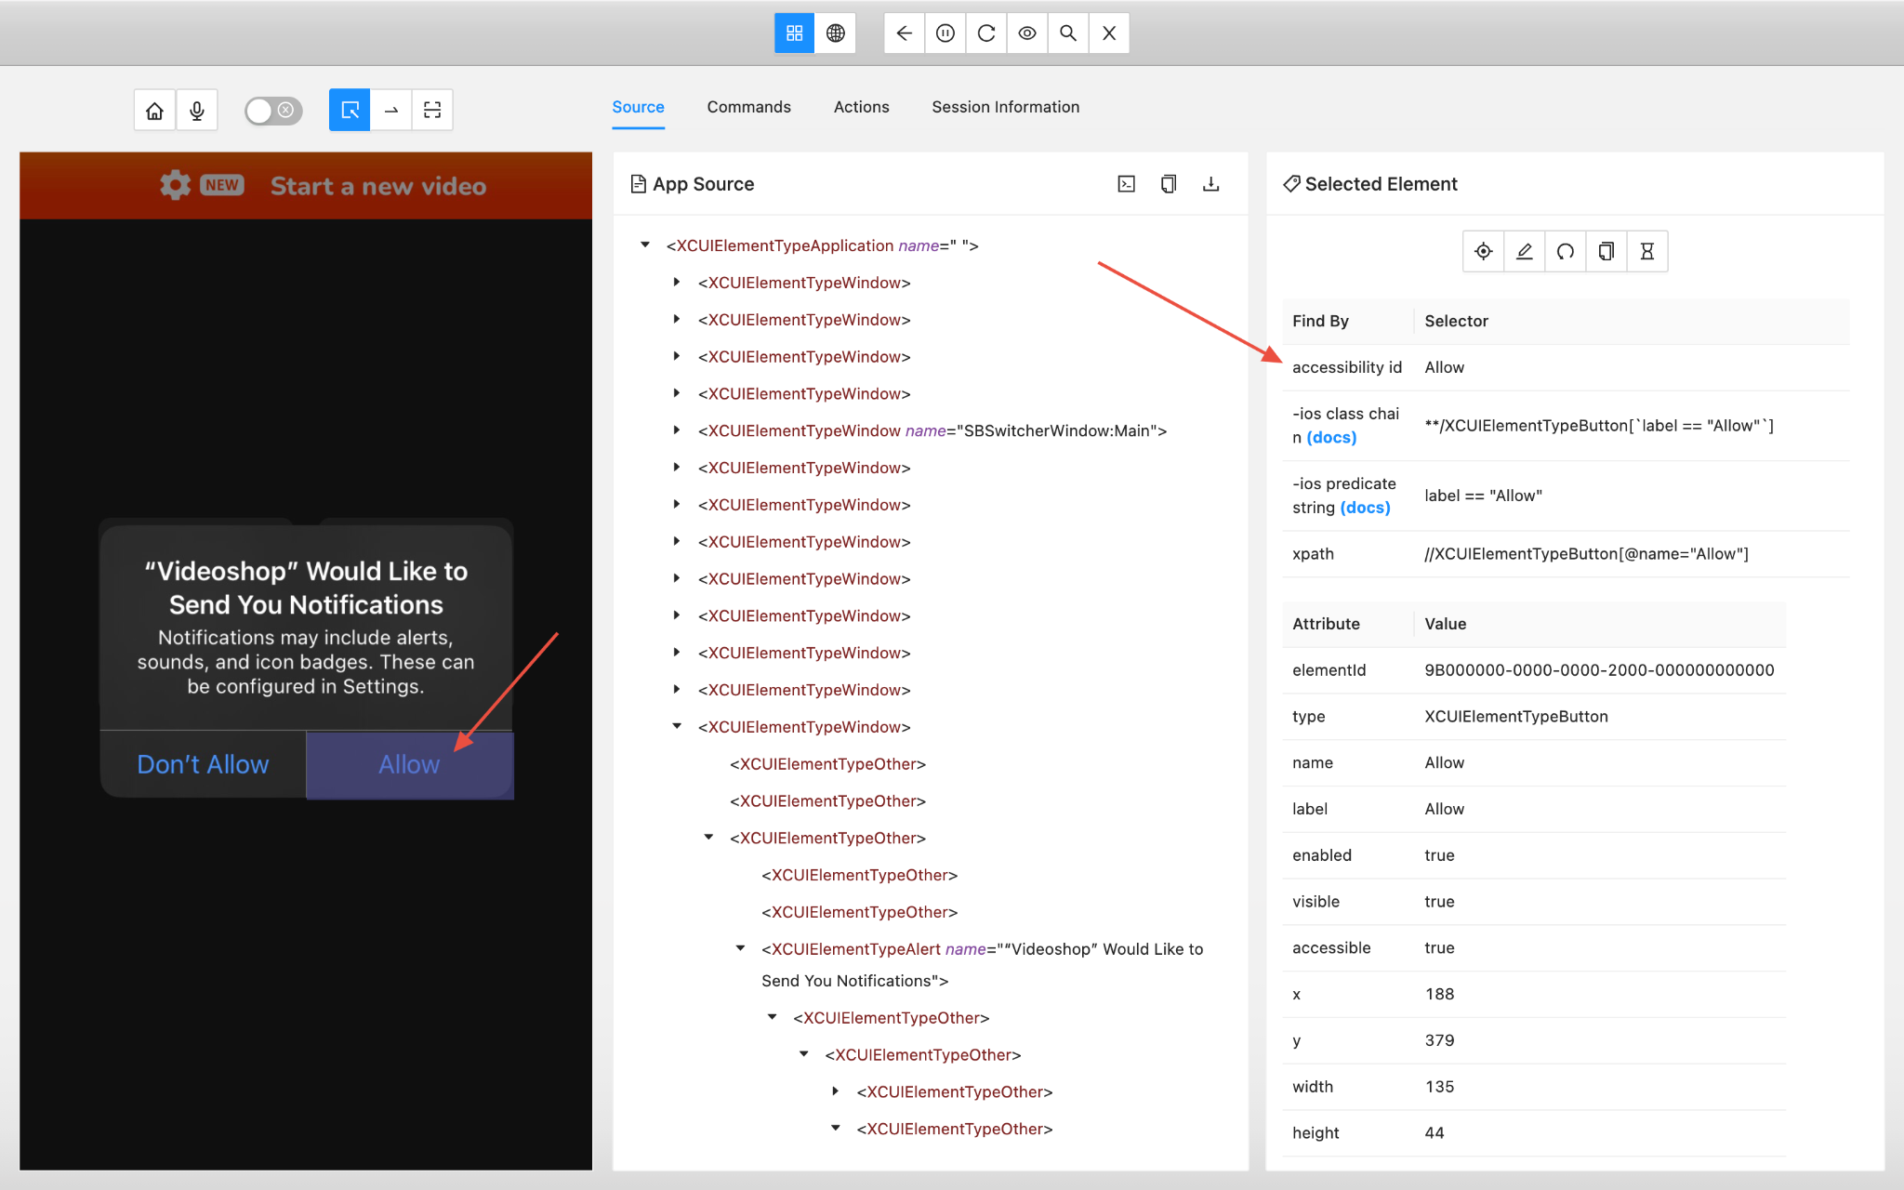
Notes:
When the button is clicked, we get its accessibility ID and path, as well as the element ID, and so on.

Slide 22
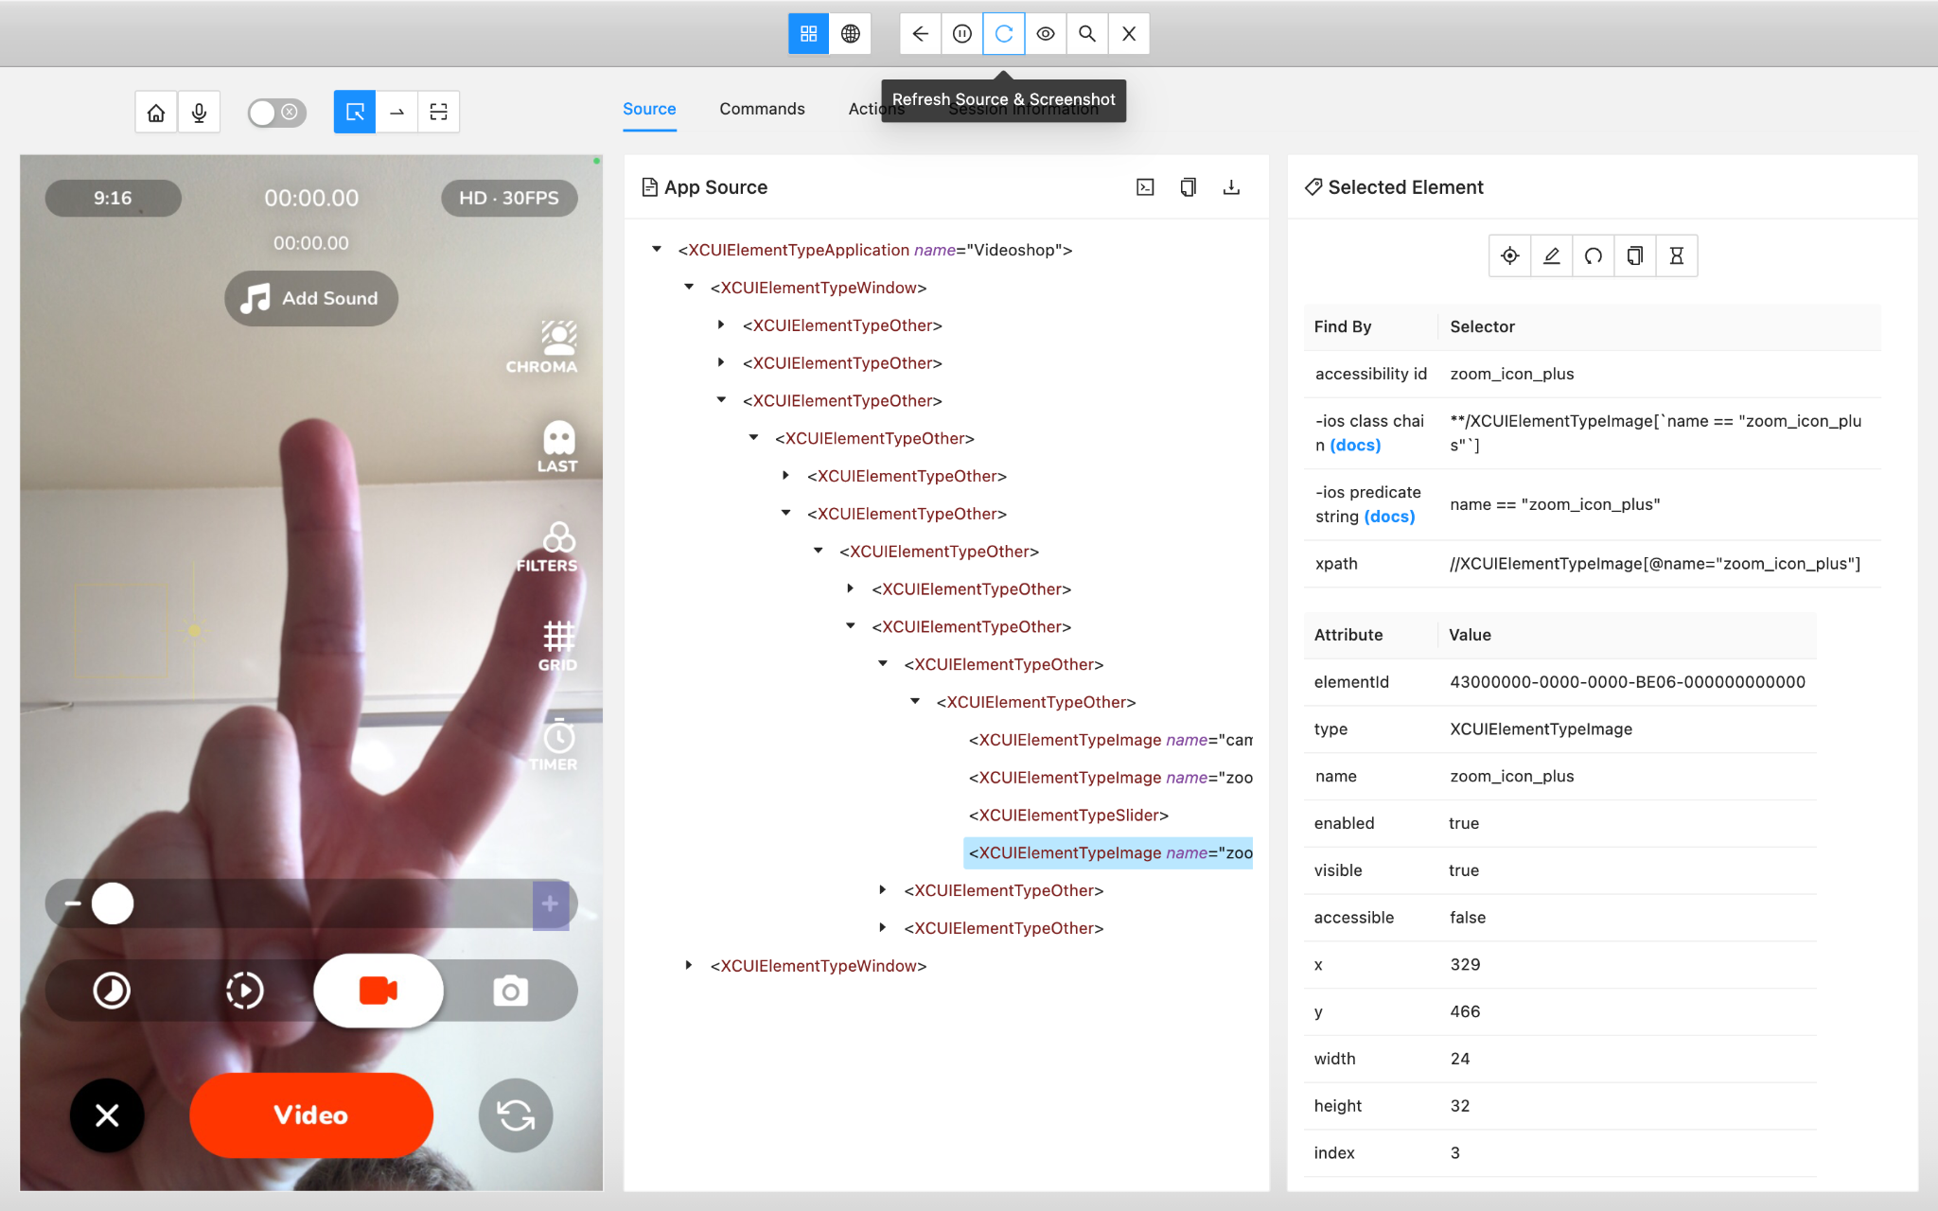
Notes:
Further, if you scrolled the screen or changed something on a real device, then in the inspector you will need to click on the update source and screenshot button so that the first section of the inspector is updated.

Slide 23
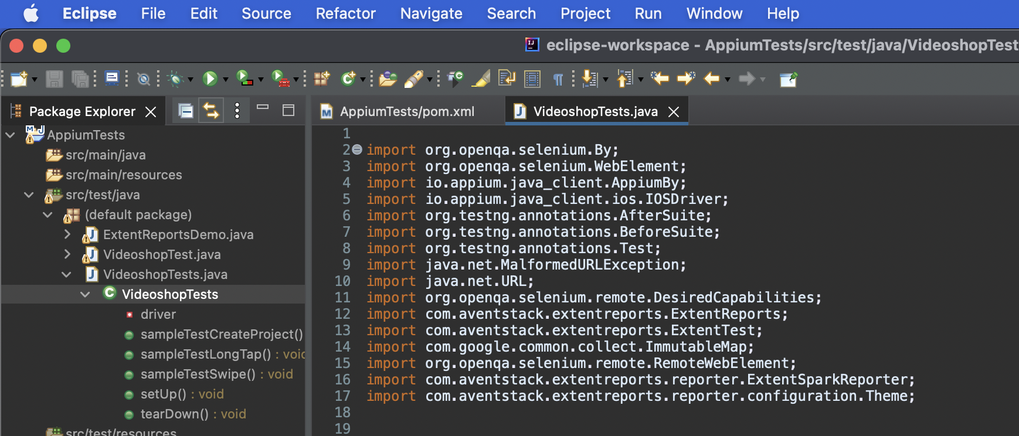
Writing a Test
Notes:
First we import libraries
Or when we declare a class and start writing code, the IDE itself will show an error and offer to add an existing library (We have already added all the necessary libraries earlier via Maven dependencies).

Slide 24
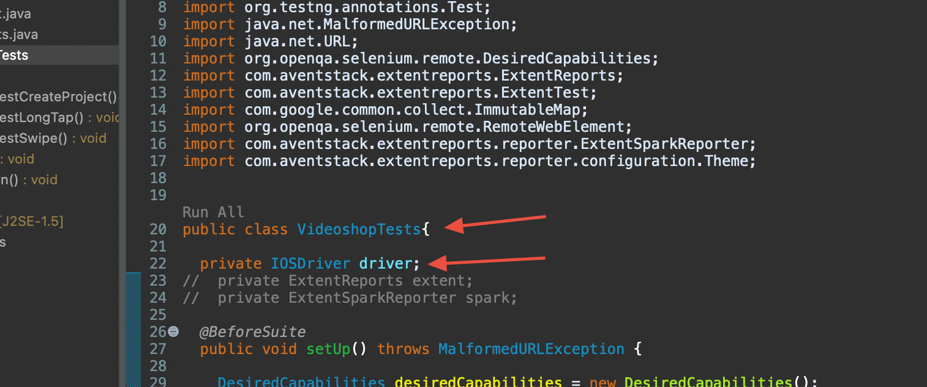
Notes:
Next, we declare the VideoshopTests class
public class VideoshopTests{
We declare the driver variable:
private IOS Driver driver;
IOSDriver is a class from Appium that provides the ability to control an iOS device or emulator. In this case, driver will be used to control the Videoshop application.

Slide 25
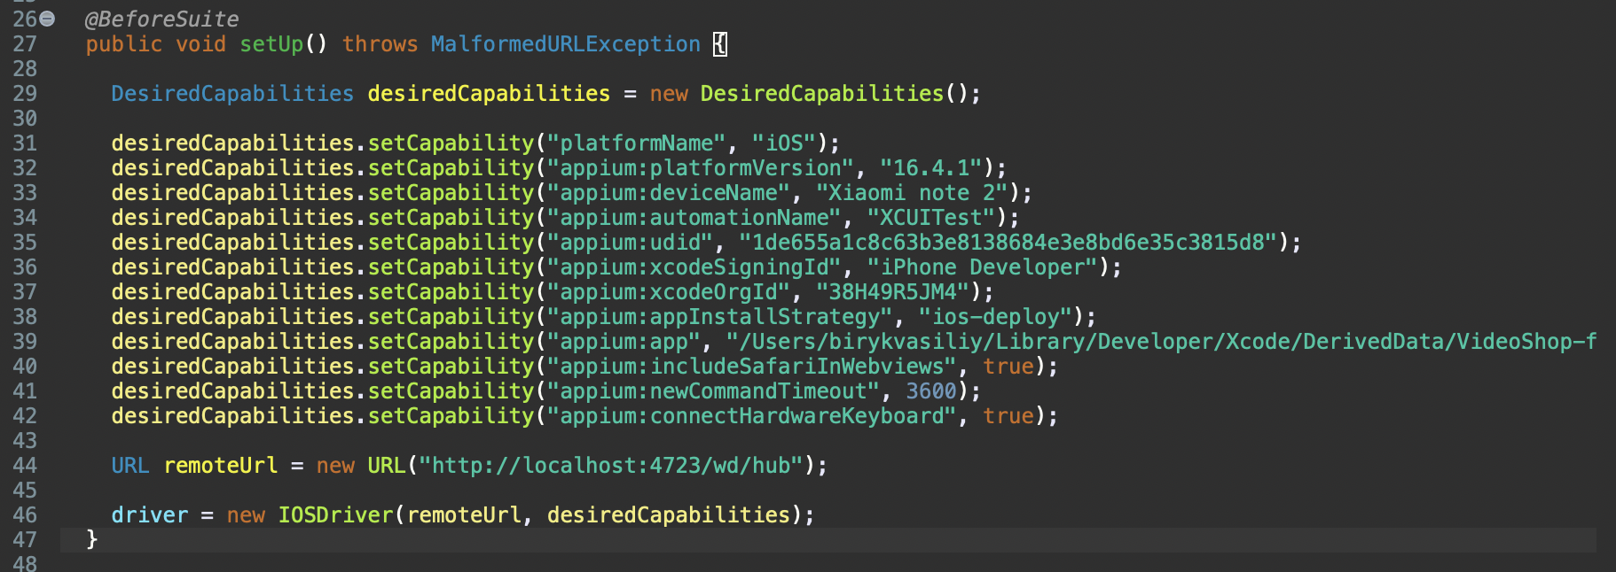
Notes:
setUp() method:
@BeforeSuite
public void setUp() throws MalformedURLException {
DesiredCapabilities desiredCapabilities = new DesiredCapabilities();
// Set the desired parameters for connecting to an iOS device or emulator
// For example, specifying the platform, version, device name, etc.
// ...
URL remoteUrl = new URL("http://localhost:4723/wd/hub");
// Create an instance of IOSDriver with the specified parameters
driver = new IOSDriver(remoteUrl, desiredCapabilities);
}
The setUp() method is executed before each test (@BeforeSuite). It sets the desired parameters for connecting to an iOS device or simulator, creates an IOSDriver instance and assigns it to the driver variable.

Slide 26
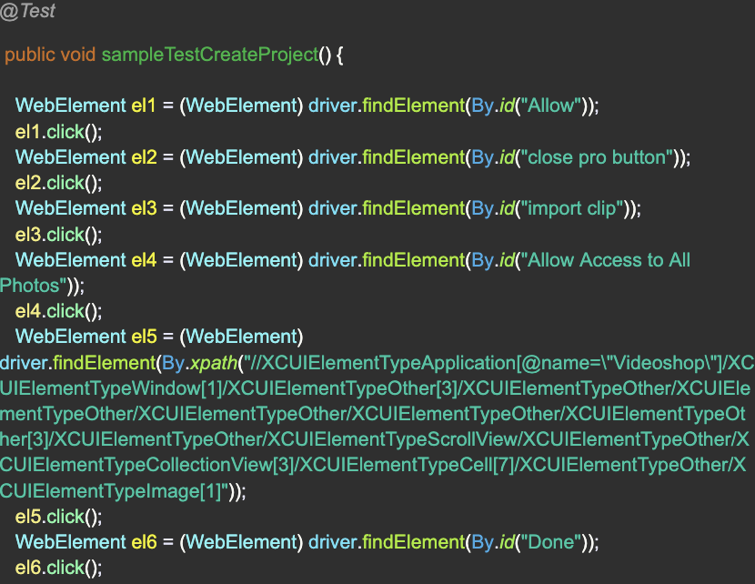

Notes:
@Test function and methods:
In this function, we declare a method and write a test inside it.
For example, here is a simple test where we use just regular taps to create a project inside the application (find element by accessibility id or xpath using
WebElement el1 = (WebElement) driver.findElement(By.id("Allow")); and then we tap on this element el1.click();

Slide 27
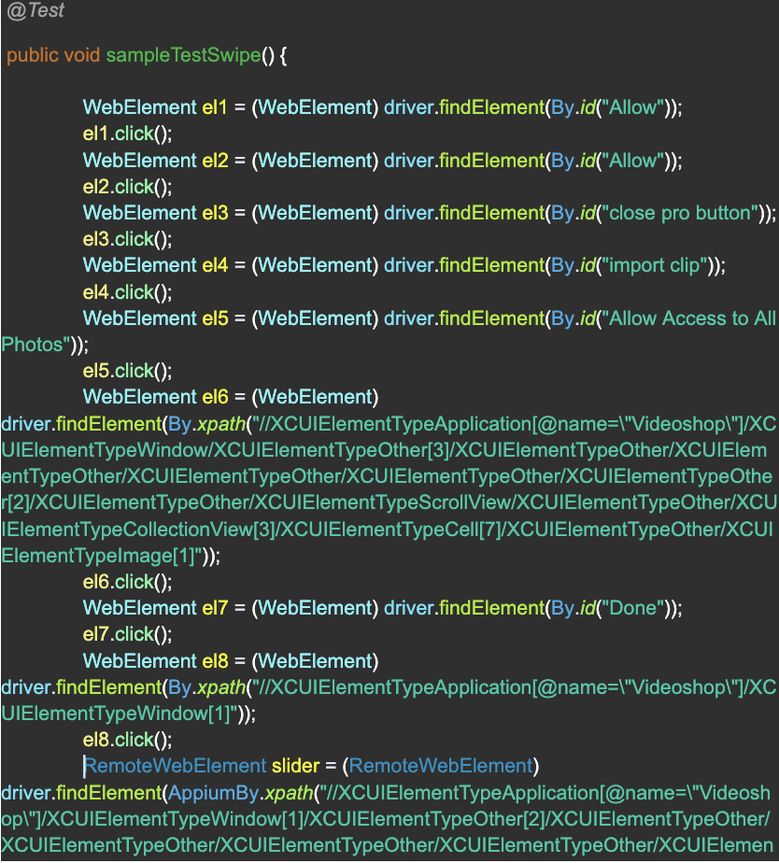

Notes:
Let's add some gestures that can be used in tests. Below is an example of using swipe. I created a project and swiped the timeframe. Used gestures from a previously installed plugin
https://github.com/AppiumTestDistribution/appium-gestures-plugin
https://www.youtube.com/watch?v=12Qx-jl34GI

Slide 28
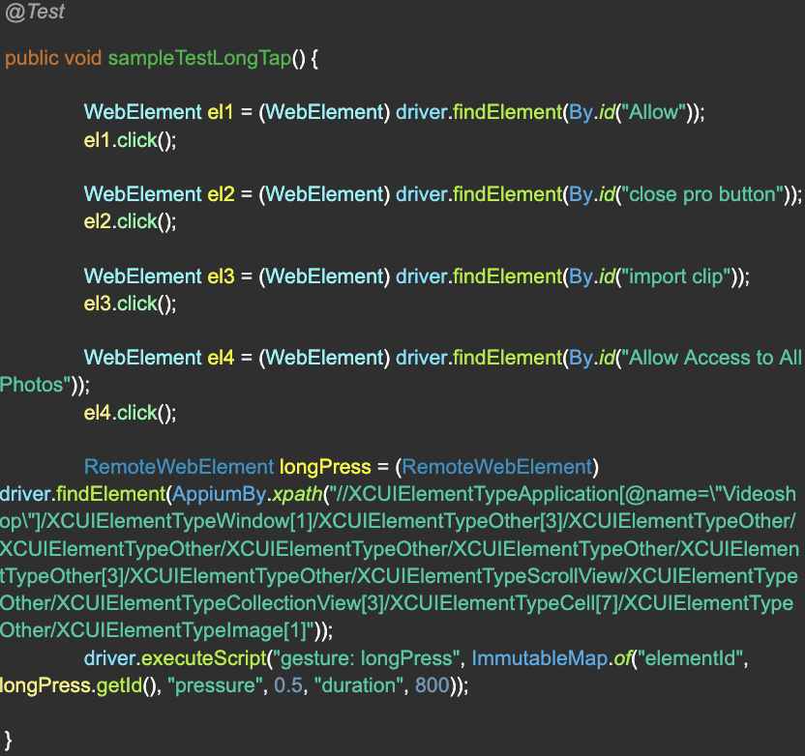
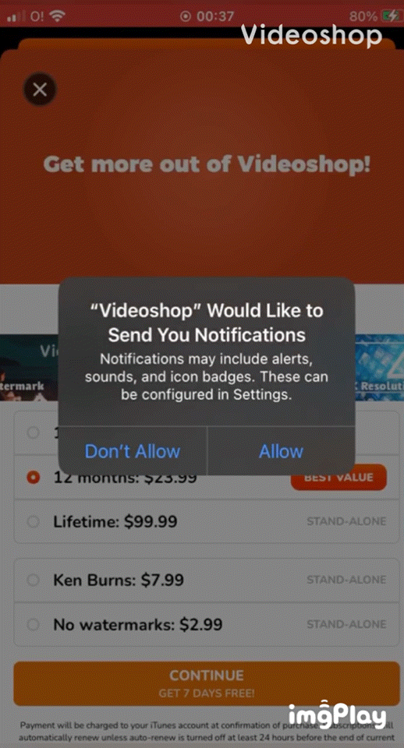
Notes:
You can also run LongPress. This shows an example of opening a clip preview on the import screen.

Slide 29

Notes:
teardown() method:
@AfterSuite
public void tearDown() {
driver.quit();
}
This piece of code represents the tearDown() method, which is executed after each test (@After). Its main purpose is to release resources, close the connection, and terminate the application session.
Inside the tearDown() method, the quit() method on the driver object is called, which terminates the application and releases all resources associated with it. This is important to keep the test execution environment stable and clean.
When the quit() method is called on the driver object, it closes the Videoshop session, exits the application, and releases all resources associated with it, such as connections and drivers.
In this way, the tearDown() method ensures that after each test runs, the Videoshop application is gracefully closed and the resources are properly deallocated. This contributes to the reliability and purity of test execution.

Slide 30
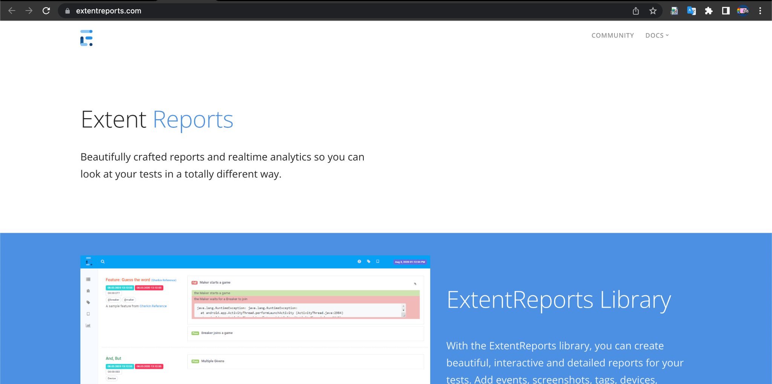
Adding an Extents Report to a Project
Notes:
Let's go to https://www.extentreports.com/ to see what kind of report we are going to create. Go to Latest Documents -> Java. There you will be able to see that it is possible to add a Maven dependency as we did earlier.

Slide 31
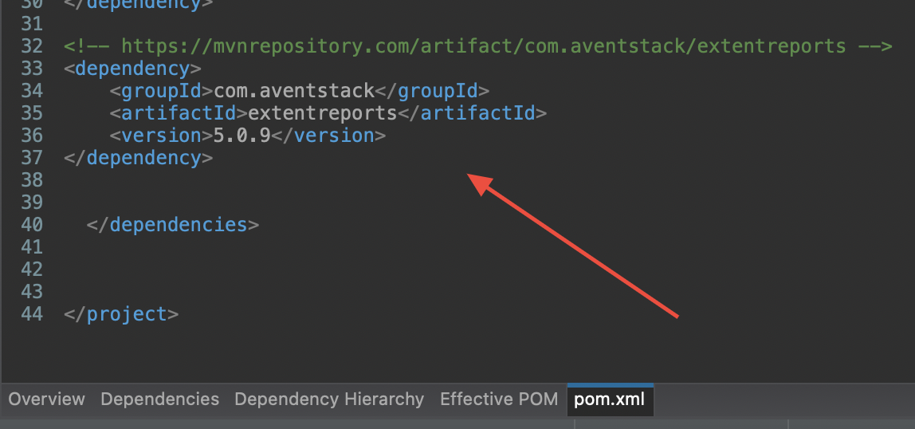
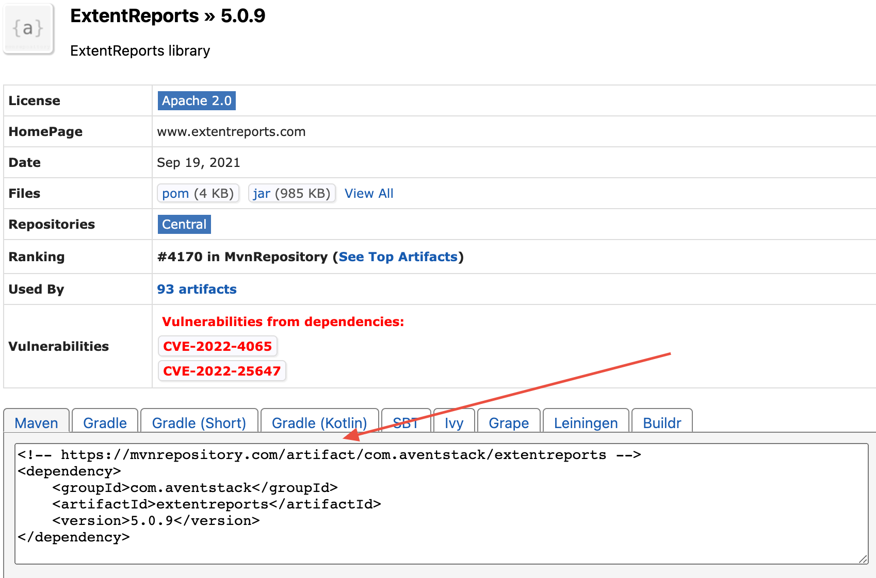
Notes:
Go to https://mvnrepository.com/artifact/com.avenstack/extentreports/5.0.9 to copy the code for Maven.
Copy the code and paste it into a pom.xml file.
Go to https://www.extentreports.com/docs/versions/3/java/index.html#basic-usage for good documentation.

Slide 32
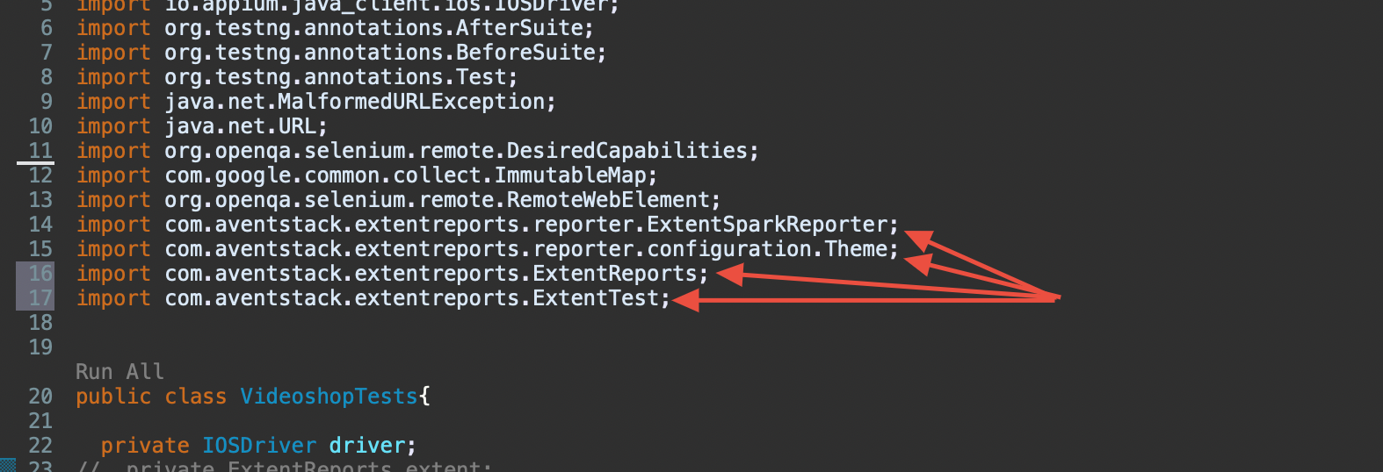
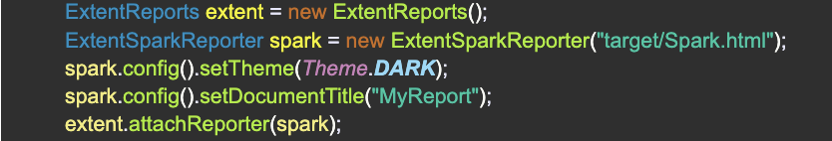
Notes:
Go to Eclipse. Inside our test class, it will be necessary to add some lines of code.
Go to https://www.extentreports.com/docs/versions/5/java/index.html#examples
Copy
ExtentReports extent = new ExtentReports();
ExtentSparkReporter spark = new ExtentSparkReporter("target/Spark.html");
spark.config().setTheme(Theme.DARK);
spark.config().setDocumentTitle("MyReport");
extent.attachReporter(spark);
And paste this code inside the @Test function right after the method declaration.
And also add four libraries
import com.avenstack.extentreports.reporter.ExtentSparkReporter;
import com.avenstack.extentreports.reporter.configuration.Theme;
import com.avenstack.extentreports.ExtentReports;
import com.avenstack.extentreports.ExtentTest;

Slide 33
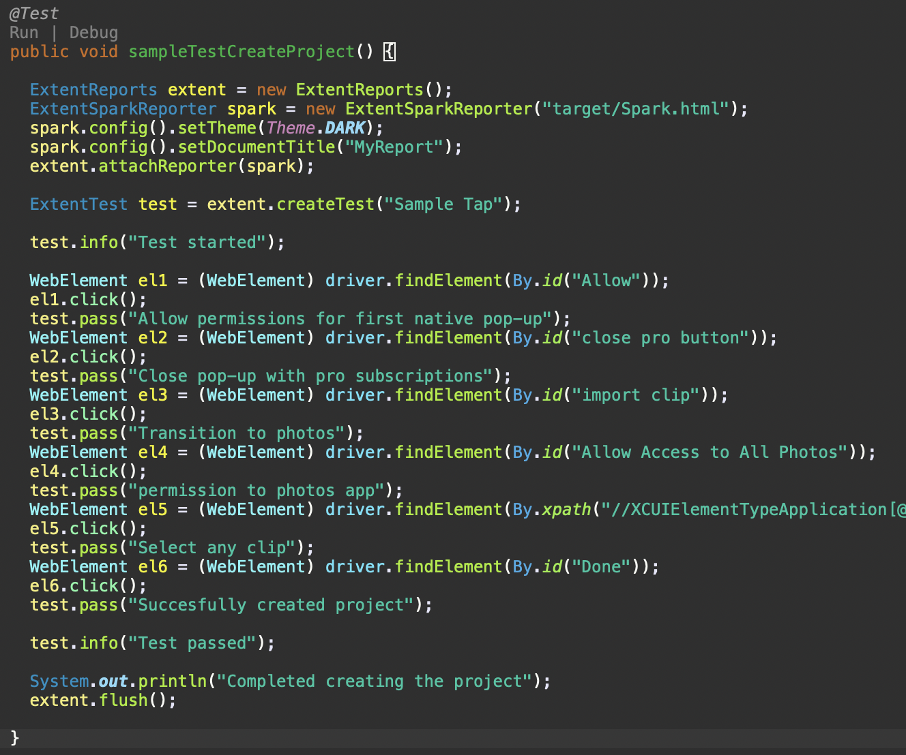
Notes:
We also need to clear the report, so write the statement “extent.flush();” which we will call last (This is written as the very last step inside the method).
You can log each step. After each step write
test. pass("Any words");
Also at the end of the test, we can use the informational status, where we say that the test is completed.
test.info("test passed");

Slide 34
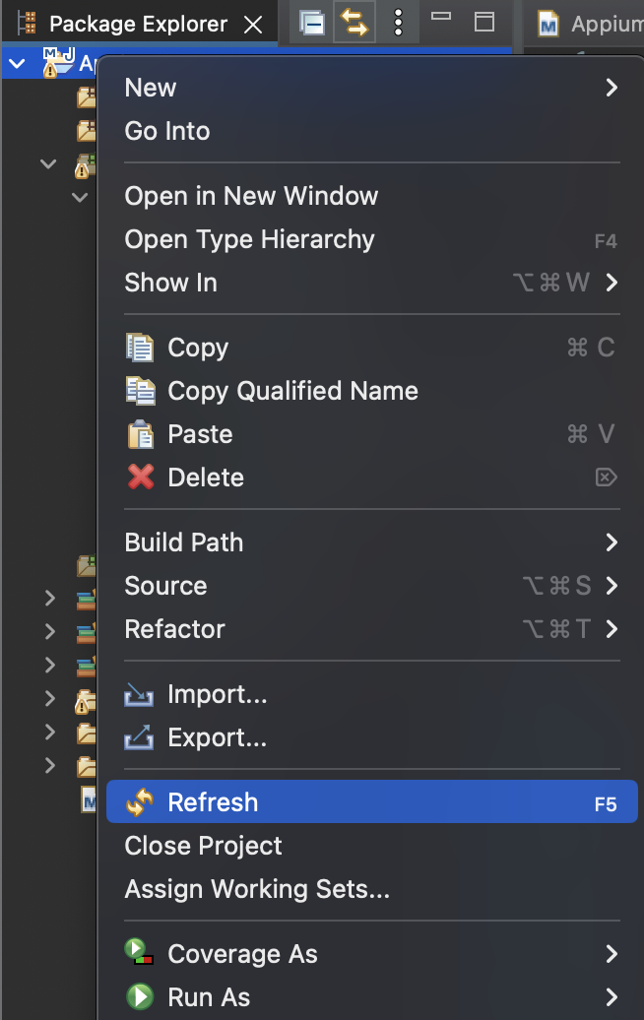
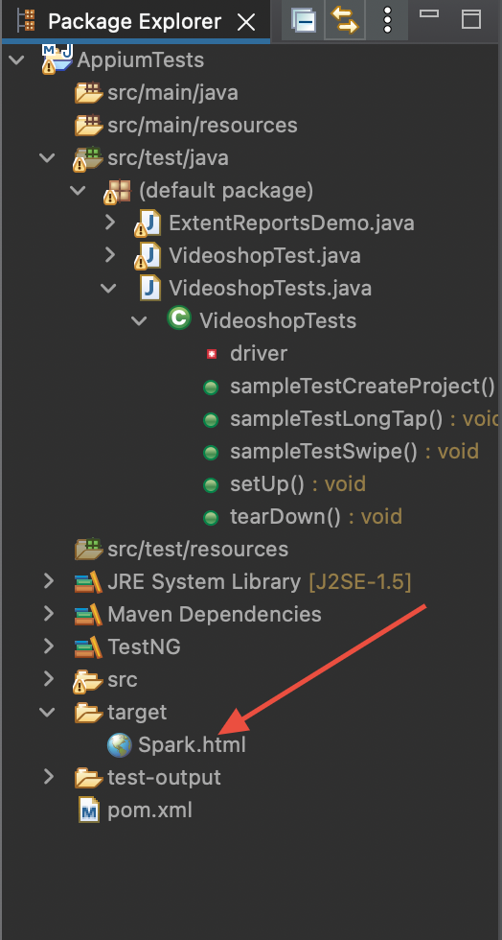
Notes:
After adding these changes, run the test on your device and after the test completes, right click on your project -> Refresh. You will see that the Spark.html button has appeared in the specified place and when you click on it twice, the html page with your report will open in the browser.

Slide 35
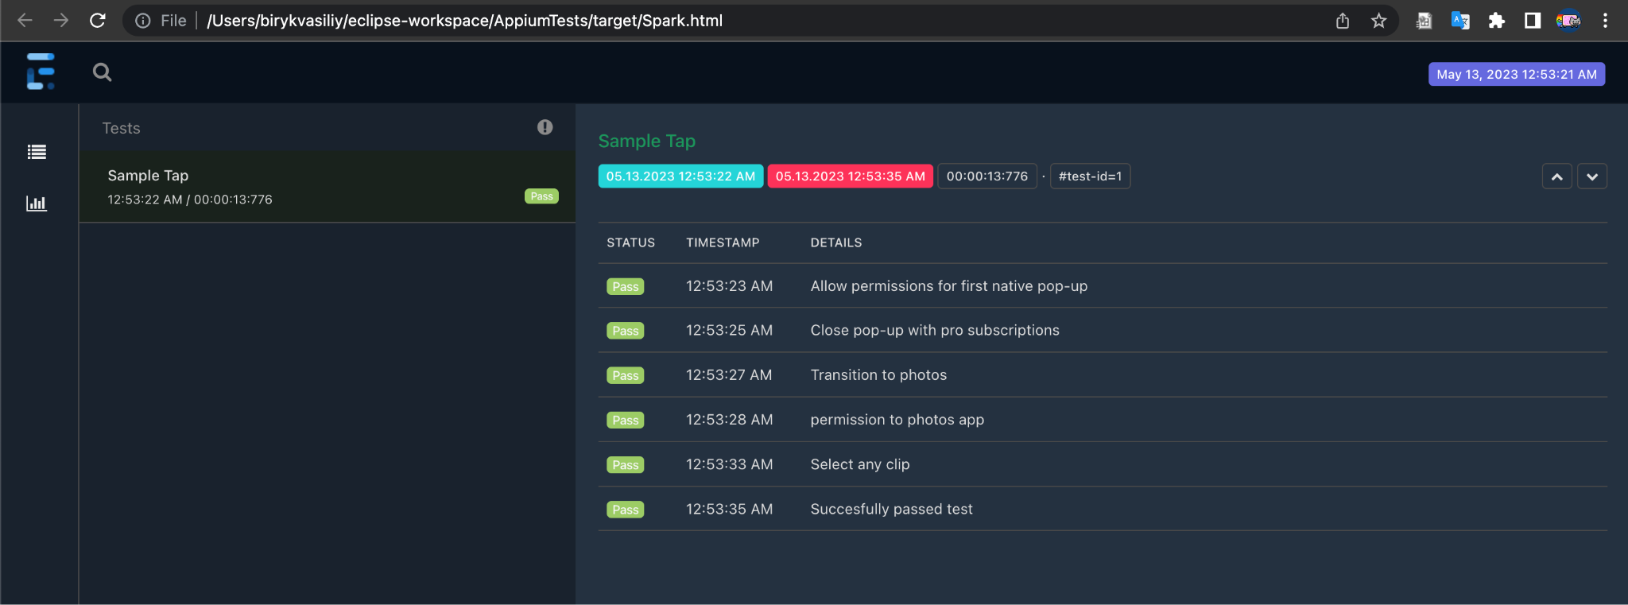
Notes:
On this page you will see the logs, you can select the log you are interested in, filters, the start and end times of the test, the time spent on it.
So we've shown how we can just use the extent reports.
https://www.youtube.com/watch?v=dRv963BmbFg&list=PLhW3qG5bs-L8npSSZD6aWdYFQ96OEduhk&index=22

Slide 36
Results
Appium is a powerful tool for creating automated tests for iOS applications. It allows you to quickly and efficiently test applications on various devices and in different conditions. The use of automated tests can significantly reduce the time spent on testing and ensure the high quality of the application.
However, it should be remembered that autotests cannot completely replace manual testing and require considerable effort and knowledge in the field of programming. However, when used correctly, autotests can achieve great time and resource savings, making them an integral part of mobile app development.

Slide 37
Useful sources
A book with a translation into Russian by Appium 1 part - https://habr.com/ru/articles/331224/ (Here you will find the following parts of the book)
YouTube channel - https://www.youtube.com/watch?v=mAylNVddfJc&list=PLhW3qG5bs-L8npSSZD6aWdYFQ96OEduhk&index=1 (The only negative is that the data is not updated, most of my time was spent fixing everything he showed up to date)
Gesture information - https://www.youtube.com/watch?v=MHgSAmDXIWs&list=PL9ok7C7Yn9A-yUEnE62gOQ2B4pL3gsC28&index=2

